Slide 1
A Grand Unified Theory of Software
Vinod Dinakaran
BarcampBangalore XII

Slide 2
A Grand Unified Theory of Software
Towards
Vinod Dinakaran
BarcampBangalore XII

Slide 3
I’ll talk about…
The problem
We don’t have a theory of software
So what?
Why this is a problem
An approach (or two)
How we can arrive at a Theory,
and a Grand one at that ☺
And then do what?
Use it to understand software better
and probably write software better

Slide 4

What this talk ISNT…and IS about
Theorem proving
Code Verification
Theoretical
Academic
Common Lang
Sensible Axioms
Derivable Laws
Useful models
Vocab

Slide 5
The problem

Slide 6
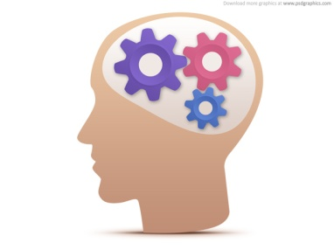
When we talk about software, we say things like….
“That codebase is super solid, very stable”
“I’ve designed that code for Flexibility and Reusability”
“It’s a huge codebase, so its pretty complex”
“That code is brittle, it breaks easily”
“That class is a point of failure”
…. And so on…

Slide 7

Meanwhile, in the real world..
Stable =
Flexibility =
Reusability =
Huge =
Complex =
Brittle =
Failure=
…. And so on…

Slide 8
Fact: We DON’T have a for software … or how its developed
precise vocabulary

Slide 9
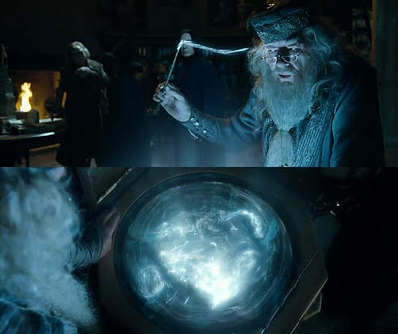
We need a Pensieve for software

Slide 10
Fact: Software development is the most important thing - the why – is lost so having a way to THINK about it is useful
Inherently lossy

Slide 11
..and then it gets worse …

Slide 12
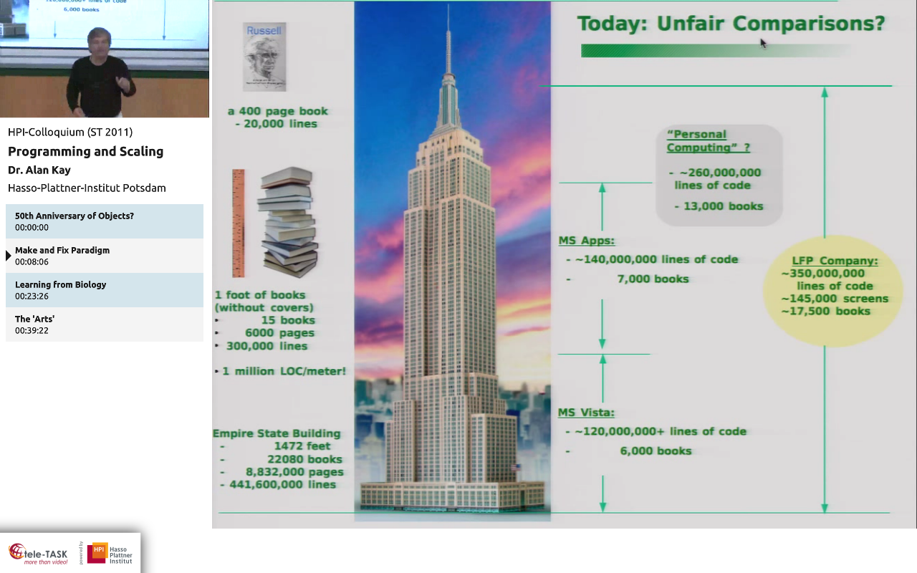

Slide 13
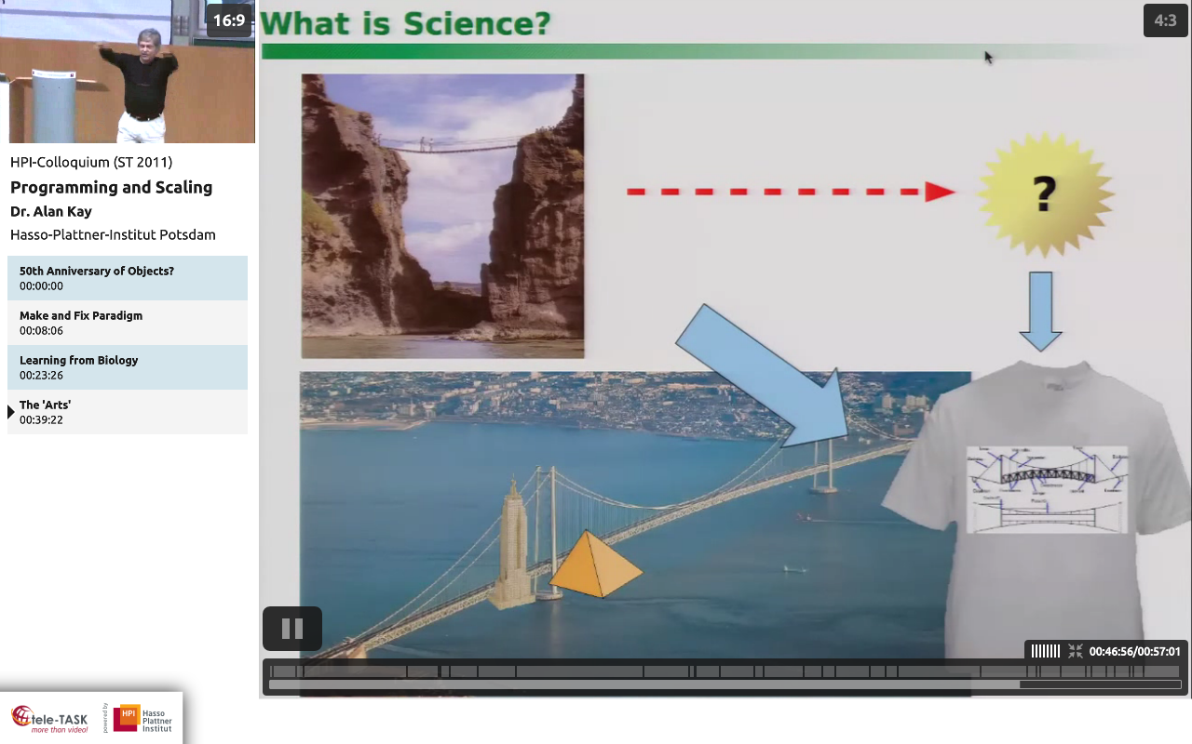

Slide 14
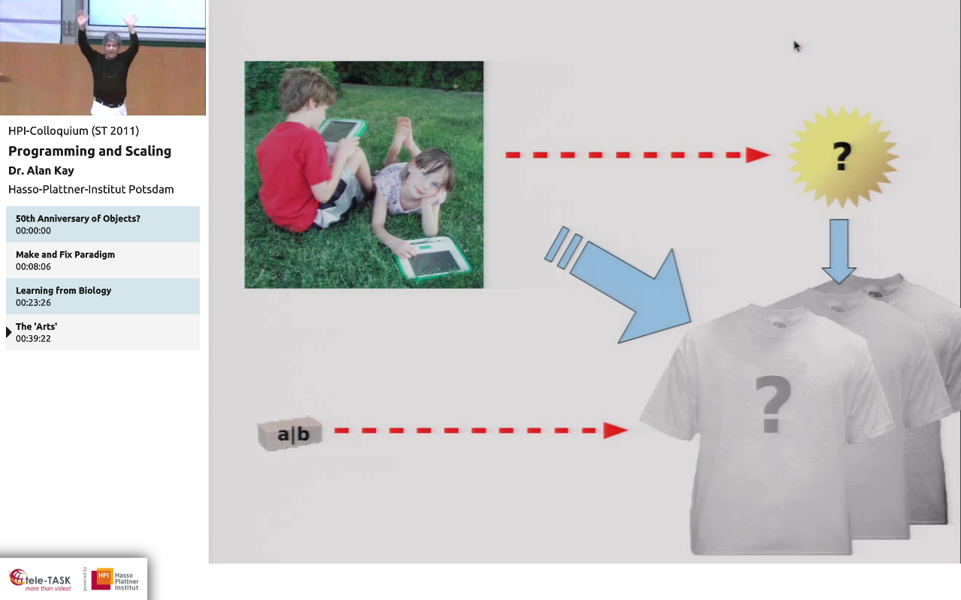

Slide 15
Fact: We no longer software that we built … at least not fully
Understand

Slide 16
But: We DO have a lot of
Micro-theories, Idioms, best practices and methodologies

Slide 17
Goto is harmful
Structured programming is good
Object Orientation is good; encapsulate state
Functional programming is good; avoid state
TDD is good; test everything!
Adding manpower to a late project makes it later
The man-month is a dangerous and fallacious myth, for it implies that man and machine are interchangeable
You ship your organization, i.e., your code has the same shape as your org structure
Release early, release often (startups)
Use old, proven technology (Mars rover)
Hardware doubles in performance every 18 months
1 program
n programs
1-n devs
1 pm
n pm’s
1 org
n orgs
the world

Slide 18
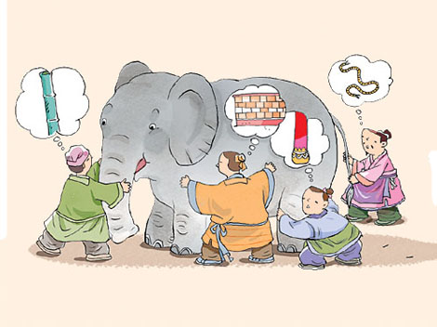
Remind you of something?

Slide 19
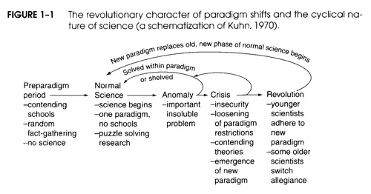

…or in comparison to science..
We are here
We need to be here

Slide 20
So what?

Slide 21
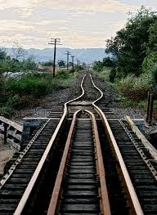
Integration

Slide 22
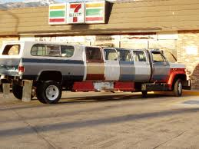
Webapp

Slide 23
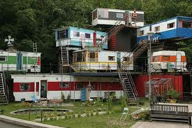
Enterprise App

Slide 24
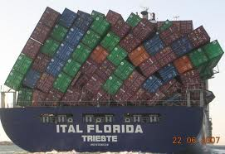
IT Org

Slide 25
I don’t mean to be trite or doomsday prophesying
…. Just putting into a few pictures what might take a whole lot of slides ☺

Slide 26
Approaches to a solution

Slide 27
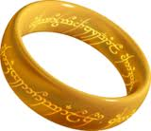
Identify
Measure
Correct
Avoid

Slide 28
One paradigm => Unified
Simple
No schools => Consistent
Defined scope
Puzzle Solving => Definition & Explanation
Research => Falsifiable

Slide 29
i.e., a Unified Theory of Software

Slide 30
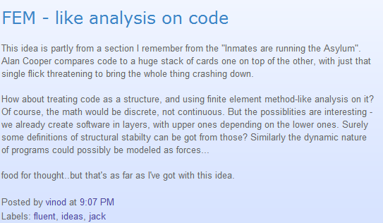
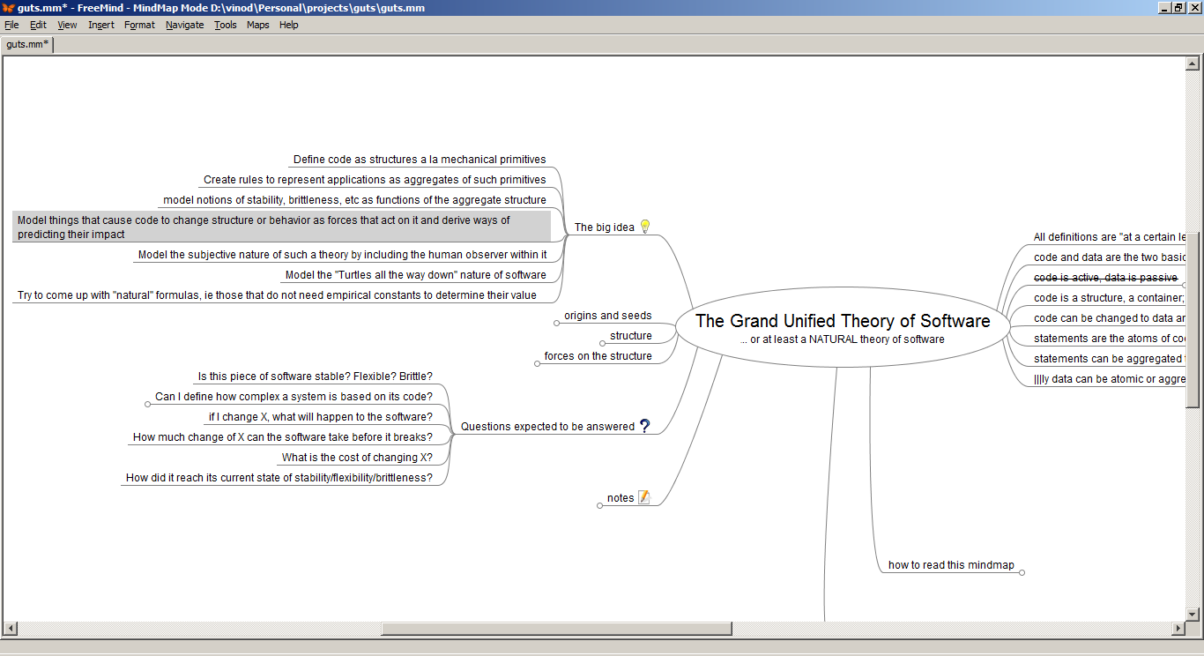
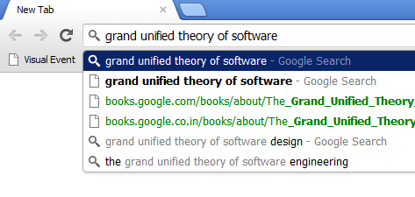

A brief tangent before we start
“Sw FEM” post
+ GUTS
Waitaminnit…
…GUTSE!

Slide 31
Two complementary approaches
GUTSE
Focus on the whole process of Software Engineering
GUTS
Focus on the outcome of the process : the Software itself;
Its evolution etc

Slide 32
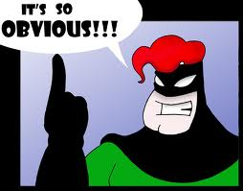
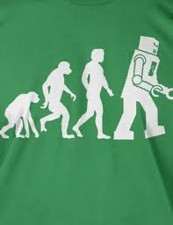
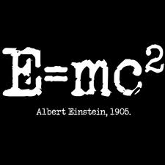

A normal science needs…
Axioms: Givens, “Taken for granted”s, universal truths
Theories: Assumptions based on the axioms
Laws: Proven theories
Application of the Science

Slide 33
GUTSE: Axioms

Slide 34
Q: What do we do when we write software?

Slide 35

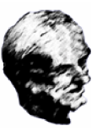
A: We solve problems using machines

Slide 36
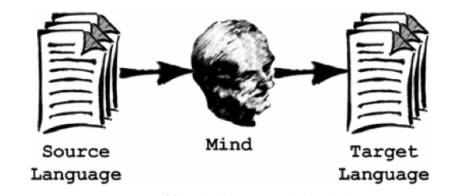
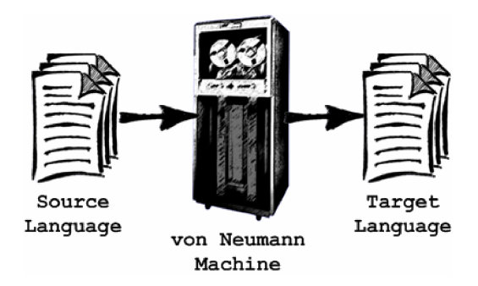
Actually…. We solve problems & encode the solutions using so that machines can run them instead of us
Coded Solution
Running Solution
Problem

Slide 37

Problem
Solution
Encoded Solution
Solution to problem

Slide 38
Axiom
All Software Development is therefore a Grand translation exercise

Slide 39
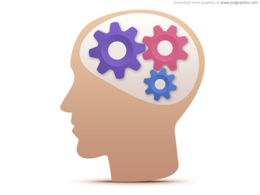
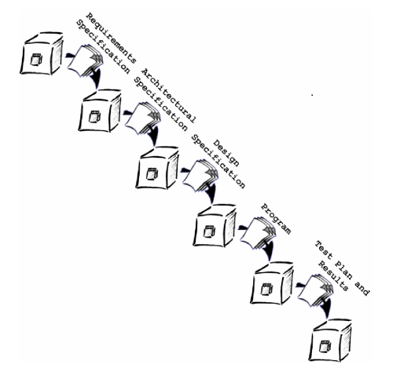
…translation of what? To what?

Slide 40


A string of symbols
Generally, A composition of building blocks
(aka Composition units)
E.g.:
Pascal: "procedure begin .... end".
whole thing is the spec, each identifier is a CU
English: "This is a sentence".
Words are CUs, sentence is the spec;
Sentences are CUs, Para is the spec;
and so forth
A set of specifications, constrained by the kind of CUs allowed to be in them
E.g.:
Java, Fortran, Assembly
Equally: Requirements Spec, Design Doc
UML
Logs

Slide 42
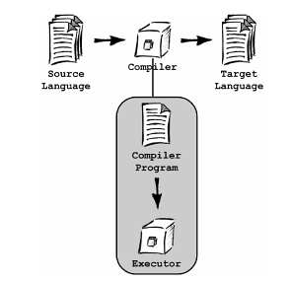
Special case: the Executor

Slide 43
Axiom
All Software Engineering can be expressed in terms of transformers and specifications

Slide 44
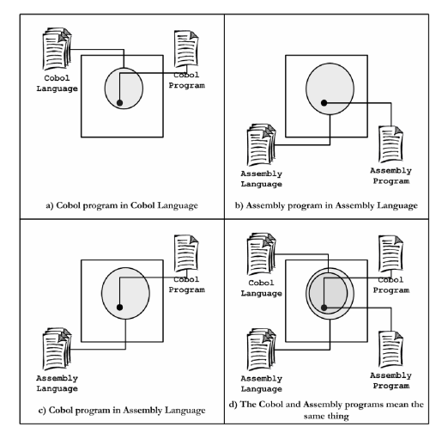
But it cant all be rote transforms, right?
A: Semantic Mappings (yes, they’re Venn Diagrams)

Slide 45
Axiom
Mapping a language to another (via a transformer) defines it in terms of the other language; thereby giving it meaning.

Slide 46
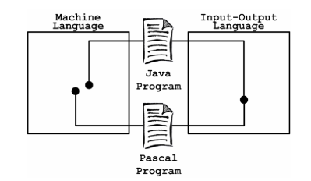
Sem-nastics: The Semantic Domain
This is a Semantic Domain because both programs mean the same in this domain

Slide 47
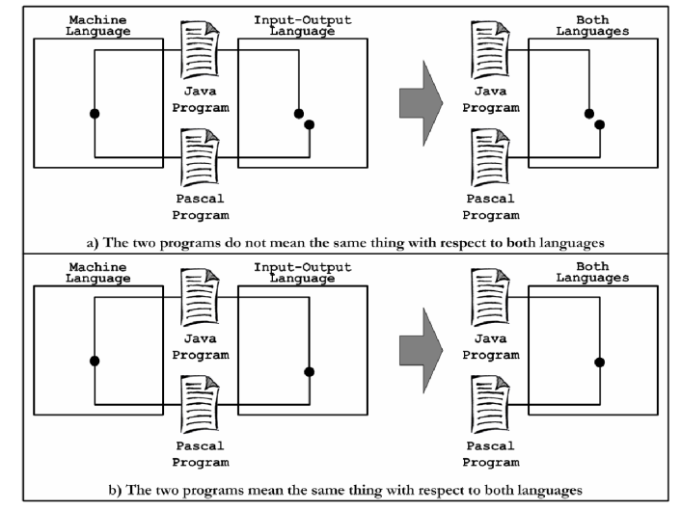
More Sem-nastics
SD
SD
SD

Slide 48
Axiom
A Semantic Domain is where semantic relations become syntactic. If two specs’ translation into an SD are syntactically equivalent, then they are also semantically equivalent.

Slide 49
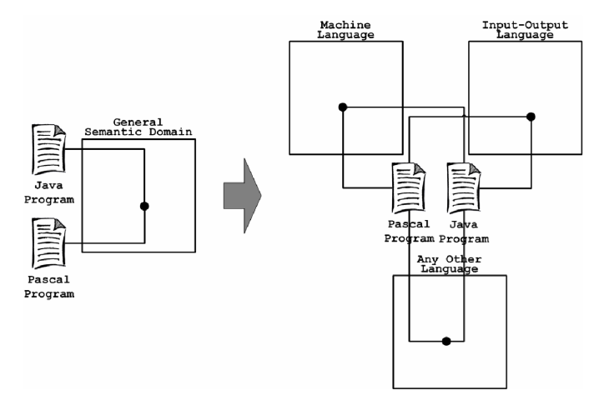
General Semantic Domain

Slide 50
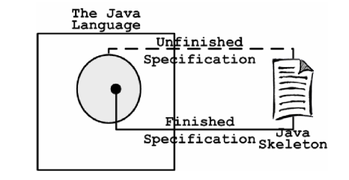
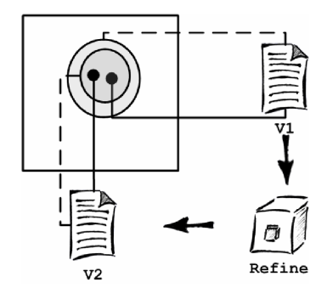
More Sem-nastics

Slide 51
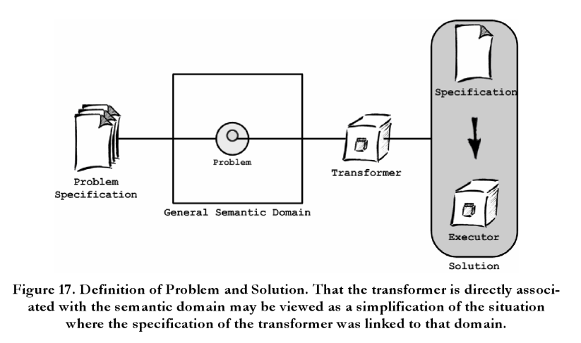
Problem Solving: GUTSE-style

Slide 52
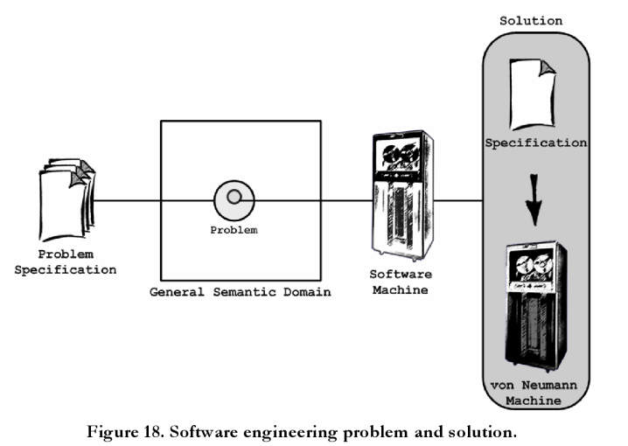
Sw Engg: GUTSE-style

Slide 53
We still need to define the machine and the mind a little bit better so that we can reason about their behavior

Slide 54
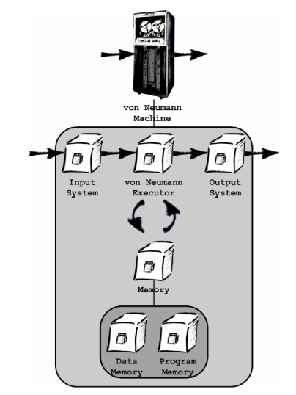
The model m/c: a Von Neumann m/c

Slide 55
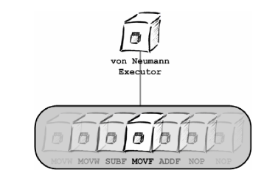
The vNM executor

Slide 56
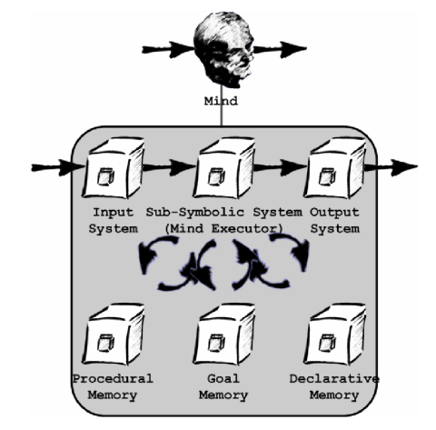
The model mind: ACT-R
Requirements:
Explain and predict problem solving
Explain and predict HUMAN problem solving
Without ignoring our understanding and learning difficulties
Concrete and operationalized.

Slide 57
ACT-R Demo

Slide 58
ACT-R Demo
E.g.: if Goal Memory has:
=goal>
isa ADDITION
n1=three
n2=four
ans=nil

Slide 59
ACT-R Demo
… and Procedural Memory has:
Add-nos
=goal>
isa ADDITION
n1=three
n2=four
ans=nil
=fact>
isa ADD-FACT
addend1=num1
addend2=num2
sum=sum
==>
=goal>
ans=sum

Slide 60
ACT-R Demo
and we indeed have a fact in Declarative Memory that asserts:
=fact3+4>
isa ADD-FACT
addend1=three
addend2=four
sum=seven
... then the mind will output
seven
… as the answer.

Slide 61
ACT-R Demo
This is a simple example, but more complex ones are:
- reasoning by counting
- retrieval from memory
- retrieval from input system (e.g., by reading a book)

Slide 62
GUTSE: Theories

Slide 63
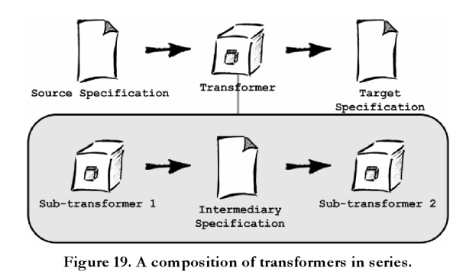
Composing transformers

Slide 64
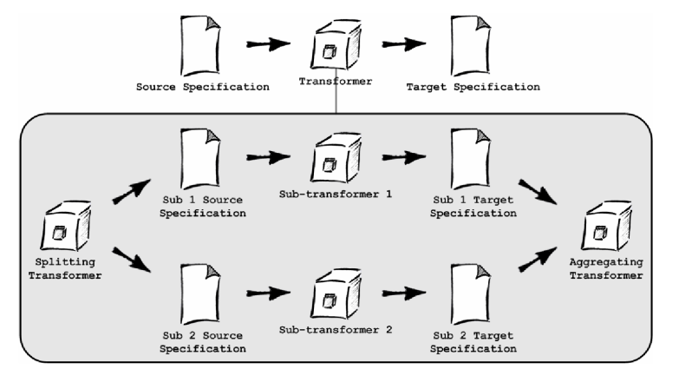
Composing Transformers

Slide 65
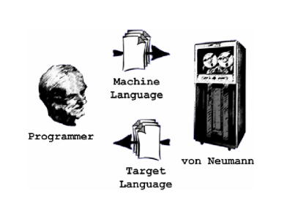
Man + m/c

Slide 66
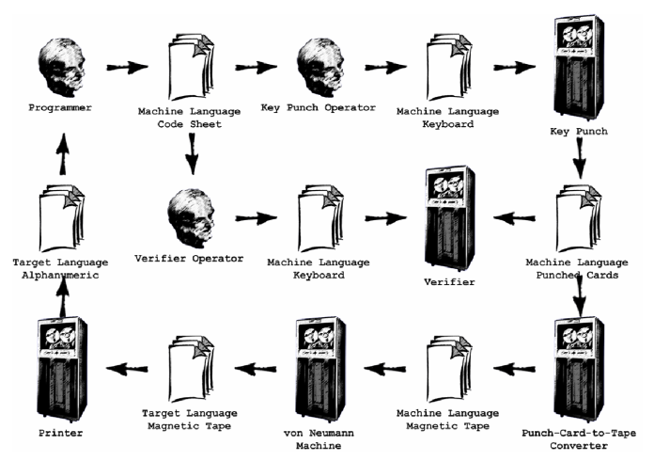
Man + m/c : Circa 1970s

Slide 67
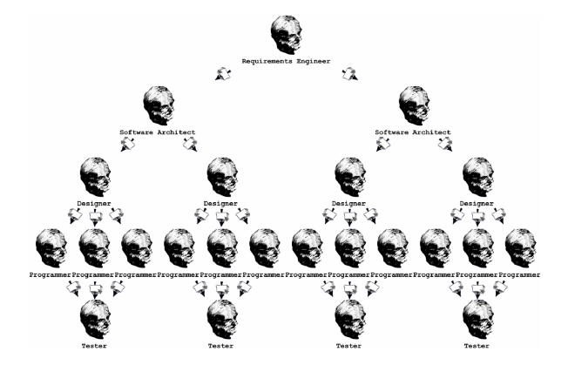
Organization: Waterfall

Slide 68
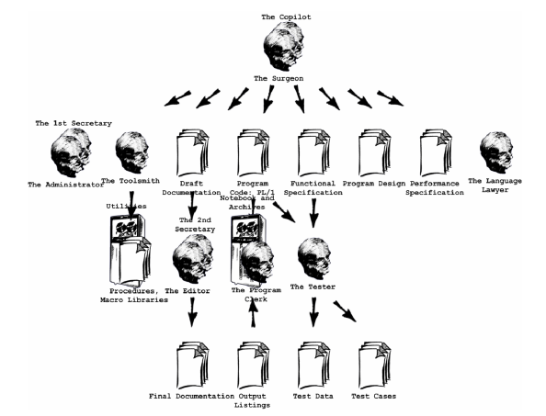
Organization: MMM

Slide 69
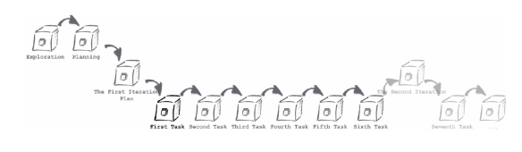
Organization: XP

Slide 70
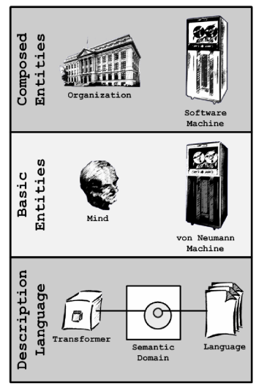
GUTSE: 50k view

Slide 71
GUTSE: Laws

Slide 72
Meta Law: no law can be stated without qualification wrt a specific SD

Slide 73
GUTSE: Application of Science

Slide 74
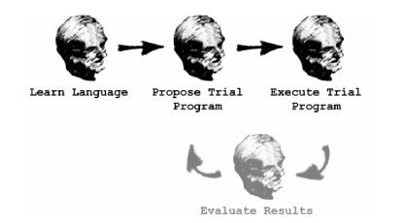
Tour de Force: Assembly vs. HLL
Q:Which is better from a Programmer’s POV?
A: Let’s model the process of learning the language, writing a trial program and then executing a real program by implementing a Bubble Sort in both
C /Assembly SD
C /Assembly Execution State Space
Lists of Numbers SD

Slide 75

… then let’s replace the human with ACT-R and see how it behaves
C /Assembly SD
C /Assembly Execution State Space
Lists of Numbers SD

Slide 76
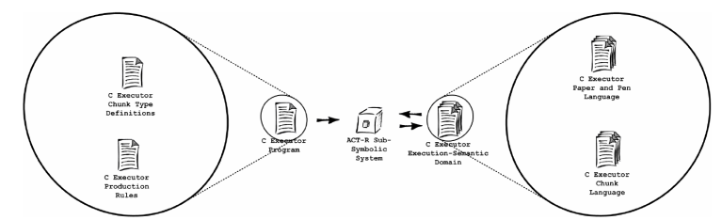
Step 0: Simulate a language in ACT-R
The Assembly machine’s ACT-R setup is essentially the same

Slide 77
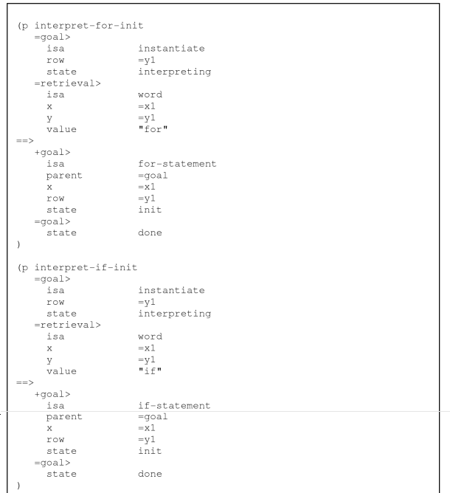
Sample Rule from Sim

Slide 78
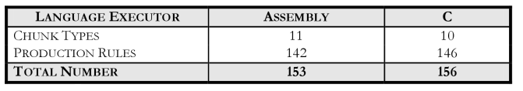
Step 1: Learn the languages

Slide 79
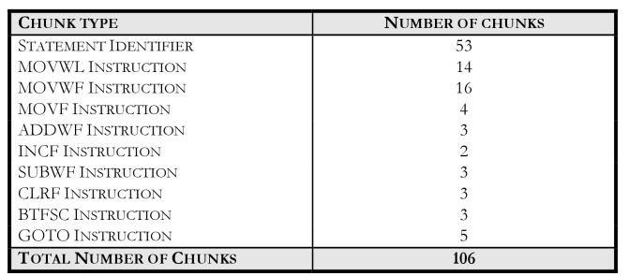
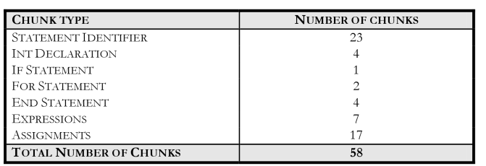
Step 2: Learn the Sort program
Assembly
C

Slide 80
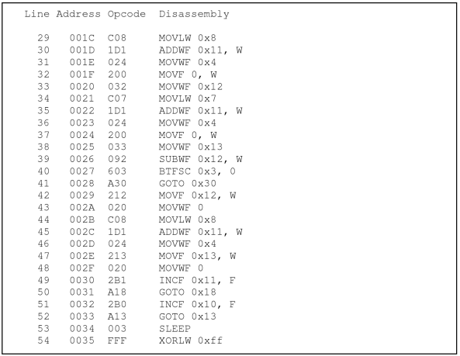
Bubble Sort in Assembly

Slide 81

Bubble Sort in C

Slide 82

Step 3: Simulate run of s/w bubble sort m/c’s written in Assembly & C

Slide 83

Bubble Sort m/c: Internals
The C machine’s internal view is essentially the same

Slide 84

Bubble Sort m/c: Simulated Internals

Slide 85


Actual run results
~2X effort for Assembly
Overall, C wins

Slide 86
GUTS: Axioms

Slide 87
GUTS: Theories

Slide 88
GUTS: Laws

Slide 89
GUTS: Application of Science

Slide 90
And then we can do what?

Slide 91
Talk about software and its development in a universal vocabulary
Validate (or invalidate) theories, idioms and practices
Universally compare and contrast software based on its “ities” (GUTS); or even features (GUTSE – Semantic Domains)
Assess the impact of change and evolution on software
…but

Slide 92
A review… and an invite
… so this is more like a progress report than a finished product…
..but you can help finish it!
GUTSE
WIP
GUTS
WIP
YOUR THEORY

Slide 93
Questions?

Slide 94
Links
Ref | Link
Alan Kay’s Talk | http://www.tele-task.de/archive/video/flash/14029/
“FEM analysis on code” blog post | http://tt2n.blogspot.com/2009/06/fem-like-analysis-on-code.html
GUTS | https://github.com/vinodkd/guts
GUTSE | http://books.google.com/books/about/The_Grand_Unified_Theory_of_Software_Eng.html?id=TLcceL3NEiMC

Slide 95
Thank You
Vinod.dinakaran@gmail.com
+vinod.dinakaran
tt2n.blogspot.com

